Slide 1


GDPR Implementation
www.MooreStephens-ksc.ro
Precise. Proven. Performance

Slide 2

Contents
  Overview of GDPR…………………………….….…….……………………….........03
  Implications on Data Controllers’ Activity……………………………………..….....04
  How to Implement GDPR?.....................................................……...………….....05
  Challenges of GDPR?.....................................................………………………....06
  Cyber Risk………………………………………......................................................07
  How Moore Stephens Can Help?…………………………....................................08
www.MooreStephens-ksc.ro
Precise. Proven. Performance

Slide 3
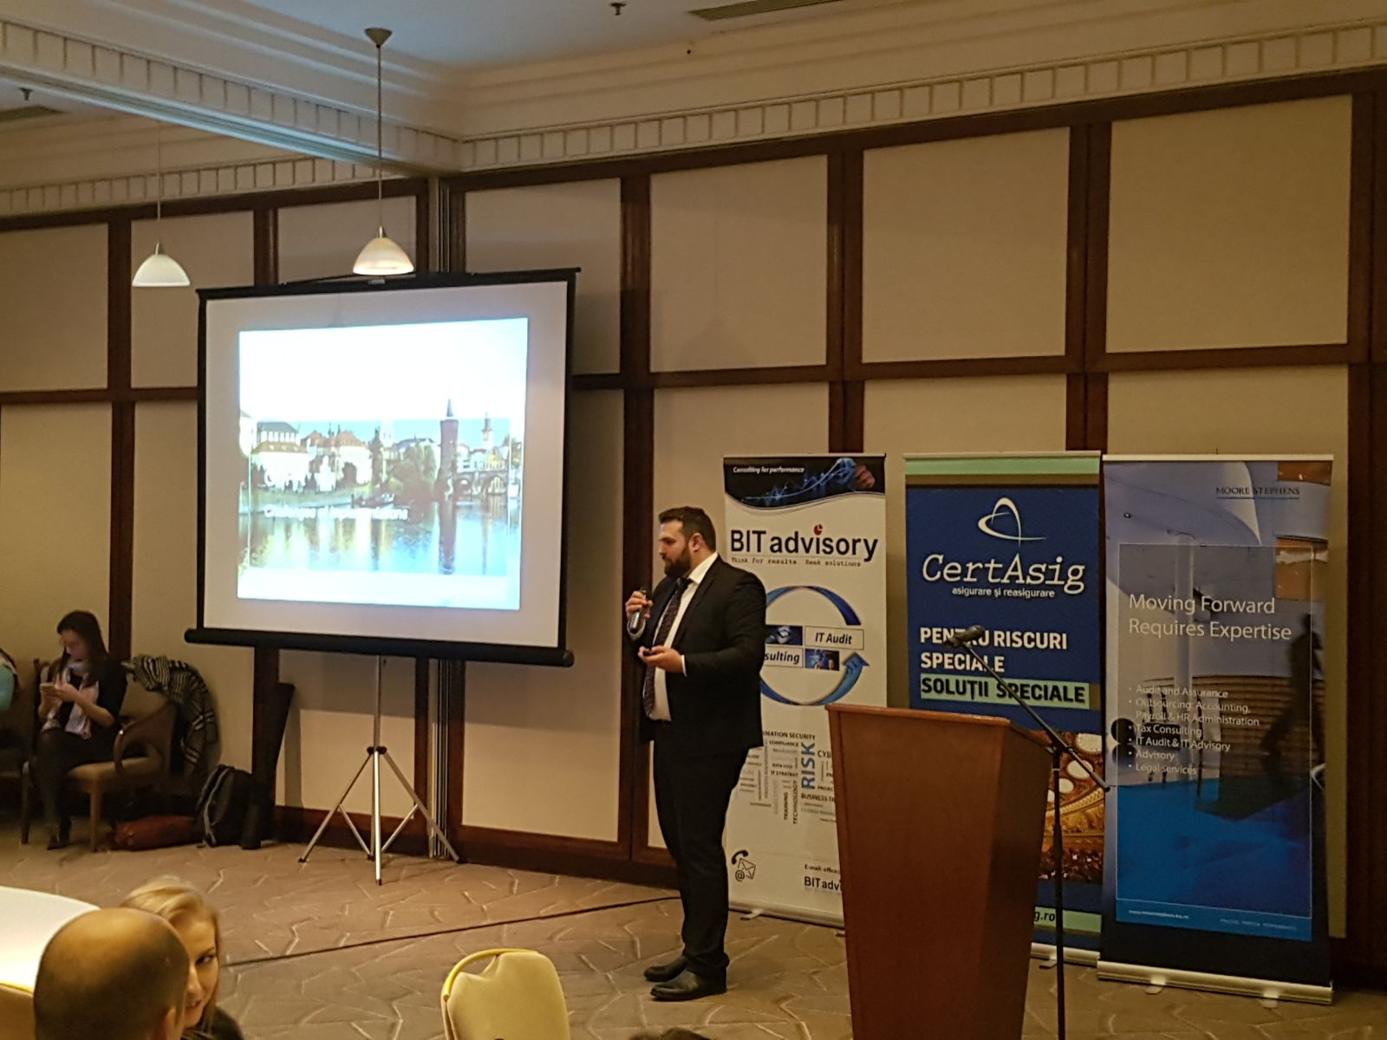
Overview of GDPR
In less than six months, Europe's data protection rules will undergo their biggest changes in two decades. The GDPR’s focus is the protection of personal data, i.e. data about individuals, and builds on existing data protection laws, setting out the responsibilities of businesses in relation to the personal data they collect, hold, transmit and otherwise use.
The GDPR is extra-territorial in nature and applies not just to organizations within the EU who process the data of individuals but also organizations outside the EU who offer goods or services to individuals in the EU, or who monitor the behavior of individuals in the EU.
Organisations have until 25 May 2018 to fully comply with the new GDPR regulations and it is imperative that organisations fully understand the requirements of GDPR and prepare well in advance to avoid being hit with heavy fines. Breaches within the regulation around the collection, usage and maintenance of personal data are significant, but the loss of customer and stakeholder confidence leading to a loss of reputation could be terminal.
The possible fines for non-compliance can start from 2-4% of the global turnover up to EUR 20 million, depending on which of them is higher.
www.MooreStephens-ksc.ro
Precise. Proven. Performance

Slide 4
Implications on Data Controllers’ Activity
Material scope
By a natural person in the course of a purely personal or household activity By competent authorities for the purpose of prevention and prosecution of offences – Directive 2016/680 Activity which falls outside the scope of Union law Activities which fall within the scope of Chapter 2 of Title V of the TEU
Territorial scope
GDPR is applicable to: Processing of personal data by a controller / processor within EU Processing of personal data of data subjects who are in the Union by a controller/processor outside EU if the processing is related to: Offering of goods or services to persons who are in the EU Monitoring the behavior of the EU persons
Data Protection Officer
Mandatory: public authorities and bodies, except courts regular and systematic monitoring of data subjects on a large scale processing on a large scale of special categories of data pursuant to Article 9 and personal data relating to criminal convictions and offences referred to in Article 10 (eg. racial or ethnic origin, political opinions, genetic data, biometric data, health data, criminal convictions)
Data Mapping
Article 30 of GDPR is applicable: Data controllers from public sector Data processors Data controllers from private sectors with more than 250 employees
DPIA
Required for processing likely to result in a high risk: Systematic and extensive evaluation through automated processing on which decisions are based that produce legal effects concerning the natural person (e.g. profiling, predicting) Processing on a large scale of special categories of data (e.g. biometric data, genetic data) or of personal data relating to criminal convictions and offenses Systematic monitoring of a publicly accessible area on a large scale (e.g. CCTV).
www.MooreStephens-ksc.ro
Precise. Proven. Performance

Slide 5
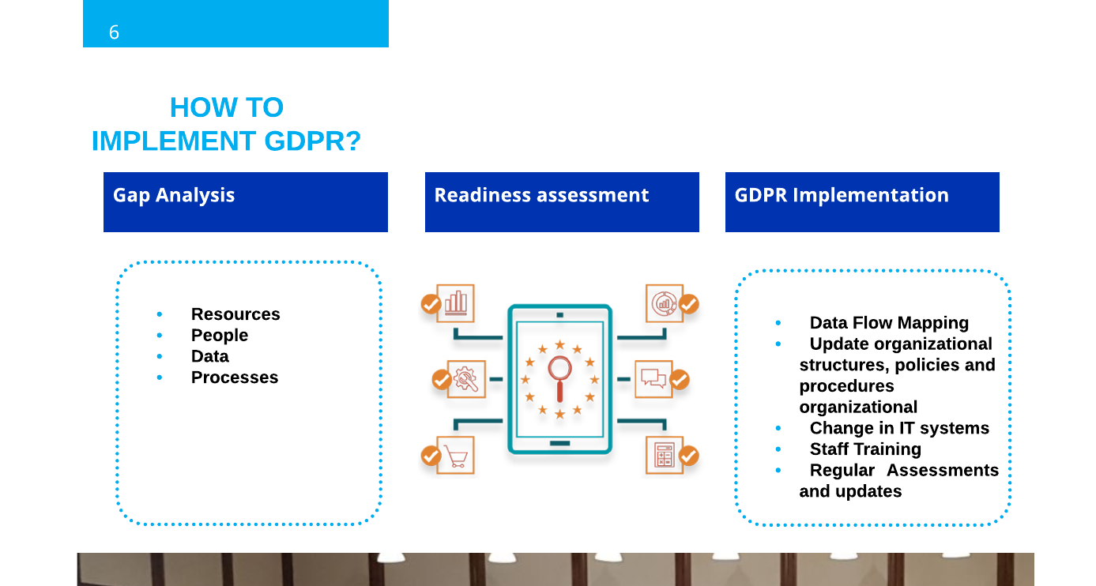
How to Implement GDPR?
www.MooreStephens-ksc.ro
Precise. Proven. Performance

Slide 6
Challenges of GDPR?
Breach notification
Notification of breaches becomes mandatory in all member states when as a result of a breach there is a risk that the rights and freedoms of individuals could become compromised. Under GDPR, the notification must be reported within 72 hours of the breach being identified. Data processors are also required to notify their customers, the controllers, “without undue delay” after identifying any breach.
Data portability GDPR introduces data portability – the right for a data subject to receive the personal data concerning them, which they have previously provided in a commonly used and machine readable format and have the right to transmit that data to another controller.
Right to access The rights of data subjects have been strengthened somewhat under GDPR. The data subject now has a right to obtain confirmation where and how their personal data is being processed, and for what purpose, from the data controller. As a result of this request, the data controller must provide a copy of the personal data held, free of charge, in an electronic format further strengthening data transparency requirements.
Right to be forgotten Under GDPR, the data subject now has the right to be forgotten which entitles the data subject to have the data controller erase their personal data, cease further dissemination of the data, and potentially have third parties halt processing of the data. The conditions for erasure include the data held no longer being relevant for the original purposes it was collected for processing, or a data subject withdrawing their consent for the data to be used. It should be noted that data controllers should compare the data subjects rights to the “public interest in the availability of the data” when considering such requests.
Privacy by design Now a legal requirement within GDPR, privacy by design calls for the inclusion of data protection from the onset of the designing of systems, rather than an addition. This will ensure that the controller meets the requirements of this regulation and protects the rights of data subjects. To do this, controllers are to hold and process only the data absolutely necessary for the completion of its duties, as well as limiting the access to personal data to those needing to act out the processing.
www.MooreStephens-ksc.ro
Precise. Proven. Performance

Slide 7
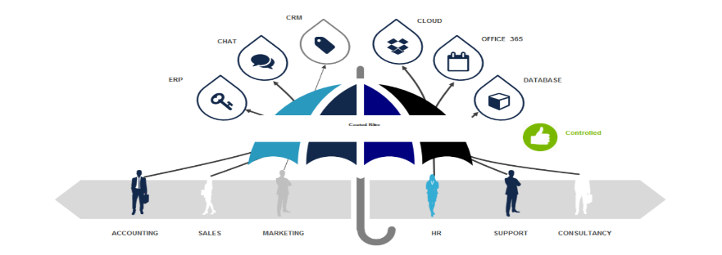
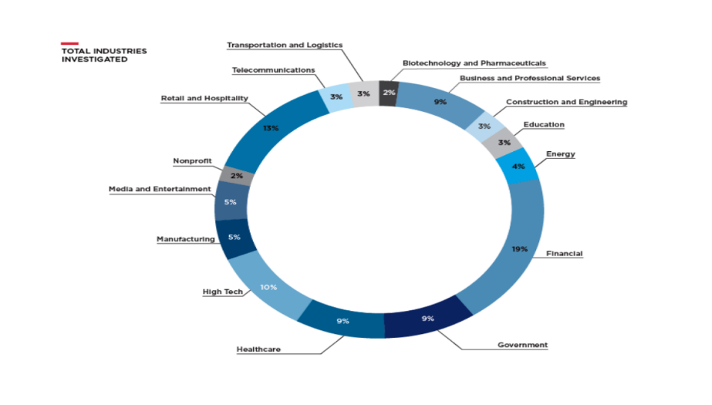
Cyber Risk
Origination of Data
Cyber Risk
60% of SMEs are bankrupt in 6 months from a cyber attack.
www.MooreStephens-ksc.ro
Precise. Proven. Performance

Slide 8
How Moore Stephens Can Help?
Educate: your senior management and employees on the changes that the GDPR will bring: ensuring that they are fully aware of regulations and how the changes will affect the organisation.
Architect your risk, policy and procedure environments to help you ensure your business operates effectively in line with the GDPR regulation requirements.
Assure the processes you have in place around GDPR giving you independent and timely information on the state of your management in relation to GDPR regulation requirements.
Manage your GDPR requirements and objectives, making sure you blend education, architecture and assurance in a way that is appropriate to your operation
Educate
GDPR Organizational Culture Benchmarking
Assure
Processes
Architect
Policies
Board Awareness
Staff Training
Third Parties
Procedures
Expected Best Standards
Risk Management
Manage
DPO Outsourcing
www.MooreStephens-ksc.ro
Precise. Proven. Performance

Slide 9

Questions?
Moore Stephens KSC
Bucharest Office 014472, 175 Calea Floreasca, Floreasca Tower building, 13th Floor, District 1 Bucharest – Romania
T:+4 0374 490 074
F:+4 0374 094 191
E:info@moorestephens-ksc.ro www.moorestephens-ksc.ro
Timisoara Office 30056, 1 Ionel Bratianu Square, Bratianu Real Estate Timisoara – Romania
T:+4 0374 490 074
F:+4 0374 094 191
E:info@moorestephens-ksc.ro www.moorestephens-ksc.ro
Chisinau Office MD 2004, 202 Stefan cel Mare Bvd., Kentford building, 9th floor Chisinau – Moldova
T:+373 22 022 555
F:+373 22 022 556
E:info@moorestephenes-ksc.md www.moorestephens-ksc.md
Mamas Koutsoyiannis CEO
(Romania/ Moldova)
Moore Stephens KSC
E:Mamas@moorestephens-ksc.ro
www.MooreStephens-ksc.ro
Precise. Proven. Performance

