Slide 1
Security measures
Introducing Risk Assessment in GDPR
Control
R = f (I, L)
R = V x T
Risk is measured as a function of its potential impact and its likelihood of occurrence.
Determine personal data lifecycle
Determine organization’s vulnerabilities
Determine the threats to the organization
Determine the risk which may arise when a threat meets one of the existing organization’s vulnerabilities
Personal Data identification
  Depending on the type of process and on the applicable legislation – determine personal data lifecycle (retention period, disposal method)
Process identification
Determining al personal data types processed
Mapping the identified personal data to organization’s processes
The identification of organization’s processes which involve personal data

Slide 2
Concepts
GDPR snapshot for organizations
Organization – Daily activities
Processing activities: activities involving personal data
Data security
Governance

Slide 3
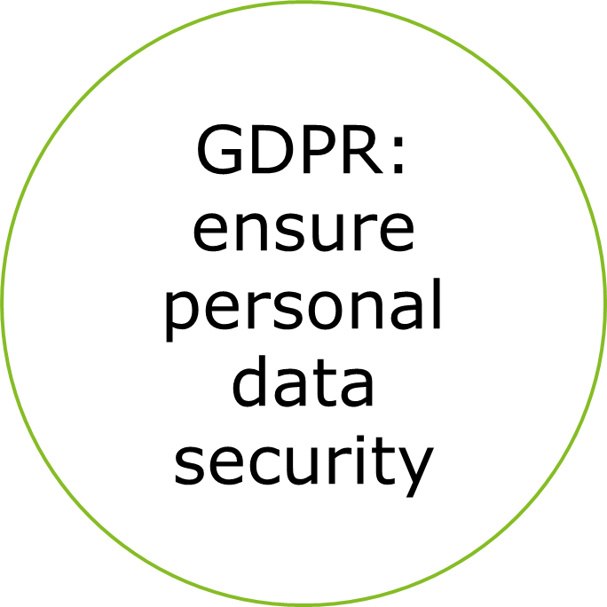
Risk Assessment
GDPR technical requirements
Integrity
Confidentiality
Availability
Pseudonymisation
Resilience
Encryption

Slide 4
Security measures
Personal data breach
A type of security incident
Breach of security leading to the accidental or unlawful destruction, loss, alteration, unauthorized disclosure of, or access to, personal data transmitted, stored or otherwise processed
GDPR requirement:
Use appropriate technical and organizational measures
Process personal data to ensure its appropriate security
Protection against unauthorized or unlawful processing
Protection against accidental loss, destruction or damage
Integrity breach
Availability breach
Confidentiality breach

Slide 5
Personal data breach
Notification and Communication
Data Protection Authority (ANSPDCP)
      72 hours after having become aware
      Risk to the rights and freedoms of natural persons
      Notification
Describe the nature of the personal data breach, categories and approximate number of data subjects and records
Name and contact details of the DPO
Describe likely consequences of breach
Describe measures taken to address the breach and mitigate adverse effects
No notification: if personal data are already publicly available (no confidentiality breach) and no availability breach
Individual (Data subject)
      Without undue delay
      High risk to the rights and freedoms of natural persons
      Communication
Describe the nature of the personal data breach
Name and contact details of the DPO
Describe likely consequences of breach
Describe measures taken to address the breach and mitigate adverse effects
Communicate to the affected data subjects directly
        If disproportionate effort – public communication

Slide 6
Personal data breach
Risk and High Risk Assessment - factors
Special characteristics of individual and controller
Consequences for individuals
Ease of individual identification
Children / vulnerable individuals
Medical organization vs. newspaper mailing list
Data about vulnerable individuals / special categories of data
Identity theft, fraud, psychological distress, humiliation, damage to reputation
Nature, sensitivity, volume of PD, number of individuals
  Directly from the data breached
  Indirectly – in combination with publicly available data
  Pseudonymisation
Type of breach
Name and address vs. name and address of foster parents
Health data
Corroborated / combined
Confidentiality breach
Availability breach
Both

Slide 7


GDPR
March 2018
Notes:
Iulia

