Slide 1
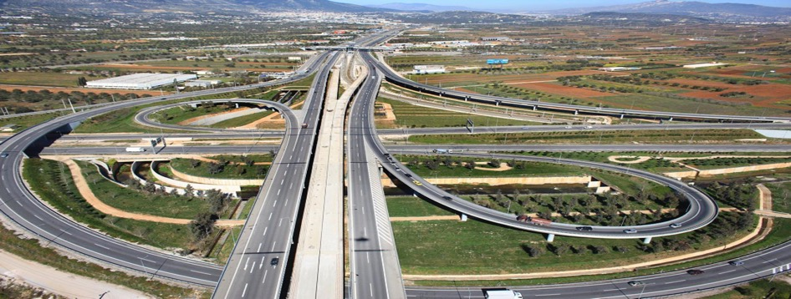
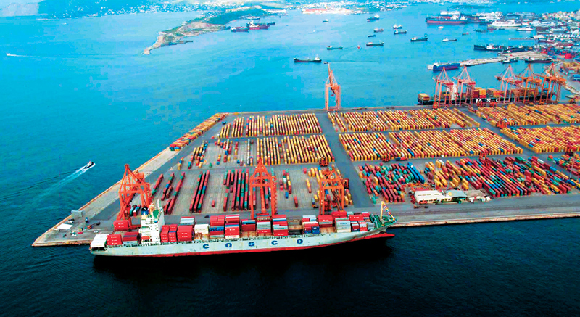
EU Funds & Project Finance
June 2018
Nikos Nezeritis, Head of Structured Finance Department

Slide 2
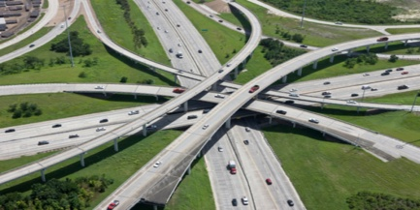


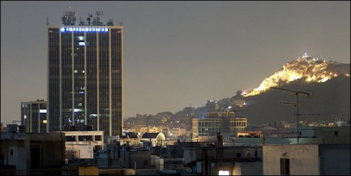
Who we are
An excellent structured financier in the local market
The Structured Finance Division consists of a team of 15 seasoned project finance professionals active in the origination, structuring, and completion of non-recourse financing for the entire Alpha Bank group.
The current structured finance portfolio is well diversified geographically as well as across the three key sectors of infrastructure, energy and real estate
Structured finance team currently manages a portfolio of > € 1bn in project finance transactions
In total we have arranged and/or participated in syndicated/bilateral more than €3billion project financings for energy projects
Transport
Energy
PPP, PFI
Real Estate

Slide 3


Who we are
An excellent structured financier in the local infrastructure market – selected 2017/2018 milestone transactions
This announcement appears as a matter of record only.
This announcement appears as a matter of record only.
T
T
T
T
RANSACTION
RANSACTION
A
S
A
S
DVISORY
Transport
DVISORY
Saudi
Aramco
Saudi
Aramco
14 Regional Airports
€965m
2017
Financial Advisor – Mandated Lead Arranger & Co-ordinator
Egnatia Odos Privatisation Exclusive Financial Advisor
Joint Venture Funding
Joint Venture Funding
US$9.8bn
US$9.8bn
Saudi Aramco.
Saudi Aramco.
PPP
This announcement appears as a matter of record only.
This announcement appears as a matter of record only.
T
T
T
RANSACTION
T
RANSACTION
A
S
A
S
DVISORY
DVISORY
Saudi
Aramco
Saudi
Aramco
Peloponnese 200ktn Waste Management
€80m
2018
Financial Advisor – Mandated Lead Arranger
Ipirus 105ktn MBT Waste Management
€50m
2017
Financial Advisor – Mandated Lead Arranger
Joint Venture Funding
Joint Venture Funding
US$9.8bn
US$9.8bn
Saudi Aramco.
Saudi Aramco.

Slide 4



Who we are
An excellent structured financier in the local infrastructure market – selected 2017/2018 recent milestone transactions
Energy
This announcement appears as a matter of record only.
T
T
This announcement appears as a matter of record only.
This announcement appears as a matter of record only.
RANSACTION
T
T
T
A
S
T
RANSACTION
DVISORY
RANSACTION
A
S
A
S
DVISORY
DVISORY
Saudi
Aramco
Saudi
Aramco
Saudi
Aramco
Joint Venture Funding
Joint Venture Funding
Joint Venture Funding
Kafireas Wind Parks 154MW
€230m
2018
Mandated Lead Arranger
Vermio Wind Park 44 MW
€52m
2018
Mandated Lead Arranger
Trikorfo Wind Parks 19MW
€30m
2018
Mandated Lead Arranger
US$9.8bn
US$9.8bn
US$9.8bn
Saudi Aramco.
Saudi Aramco.
Saudi Aramco.
This announcement appears as a matter of record only.
T
Currently arranging new transactions of more than 200MW
T
RANSACTION
A
S
DVISORY
Saudi
Aramco
Joint Venture Funding
Wind Parks Portfolio 60 MW
€80m
2017
Mandated Lead Arranger
US$9.8bn
Saudi Aramco.

Slide 5
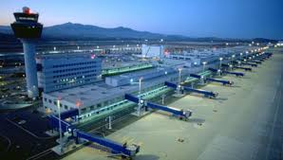
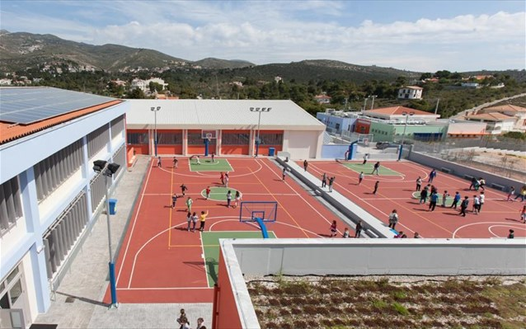
Structural Funds and Project Finance
Structural funds from EU could be proved an extremely useful tool in the context of financing infrastructure projects
Bridge the financing gap
Rationalization of user’s charge
Enhance bankability
Sectors:
Transport: Toll Roads, Airports, Ports
PPP: Environmental projects, public accommodation
An optimized combination of public and private funding

Slide 6
Contractual Arrangement
EU Funds
Special Purpose Vehicle
State / Awarding Authority
Lenders
Equity Providers
Construction Joint Venture
Interest rate Derivatives
Operating Company
LG providers
Independent Engineer
Interface Agreement

Slide 7
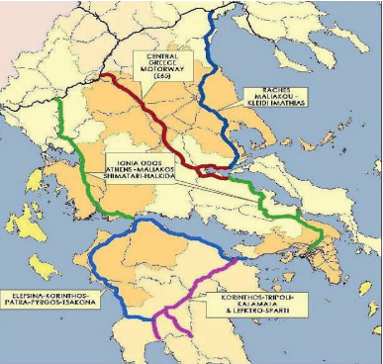
Multiproject and Bankability
A mutli project ambitious program of high standard, complex construction motorway network
Estimated Capex: €7bn
Parallel processes
An €2bn EU grant package was put in place
Increased liquidity
Enhanced bankability
c. 25 banks (c. €4 bn long term senior debt arrangement)
c. 8 sponsors
Alpha Bank is a key player in these transactions, underwriting a significant part of senior debt.

Slide 8
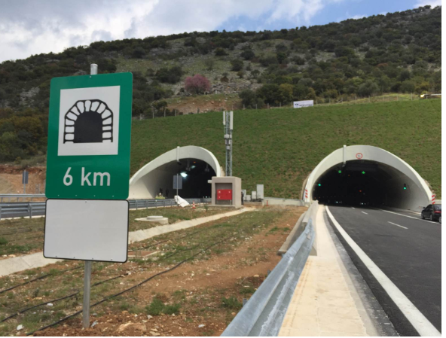
Multiproject and Bankability revisited
Financial crisis completely destroyed the envisaged financial structures and projects went to standstill
Traffic dropped by 50%
An additional €1bn EU grant package was put in place
Senior Debt was reduced to €2.5bn
Projects completed

Slide 9
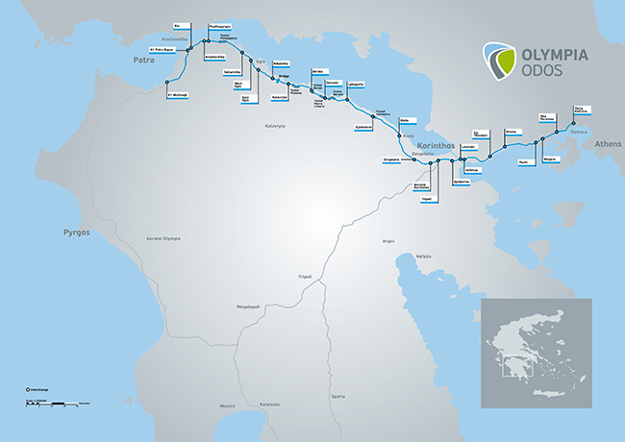
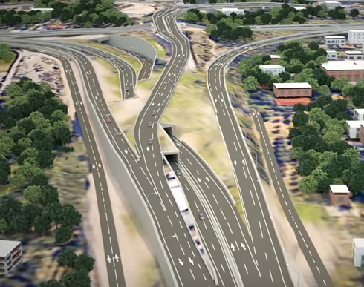
Olympia Odos Toll Road
Mandated Lead Arranger
Landmark toll road transaction project in Greece, connecting Athens with Southwestern and Northwestern (through Rio bridge) Greece;
A road network with one of the higher fatal accident rates in EU, was reduced by more than 95%;
A consortium led by Vinci and Aktor constructed a state of the art 200km road with significant tunneling works in order to minimise environmental impact;
Project Financing:
Project Cost: €2bn
Senior Bank Debt: €675m
Alpha’ Loan participation: €99m (plus €65m of IRS derivatives)
EU Funds
Originally set at €600m, was increased to €850m post restructuring

Slide 10
Sustainability
Total Price to End User
Funding Gap
Affordable Price to End User

Slide 11
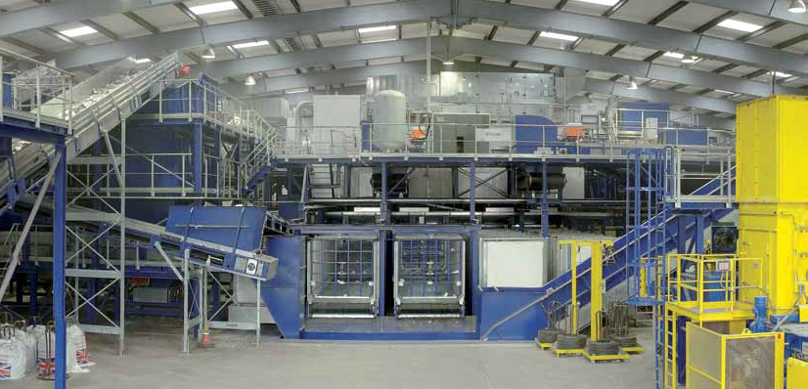
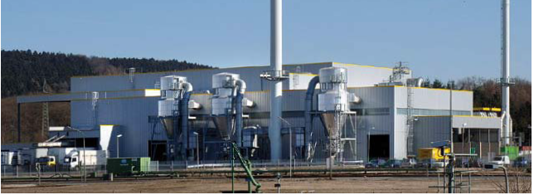
Intergraded Waste management System in Peloponnese PPP
Financial Advisor, Mandated Lead Arranger and Facility Agent
Integrated Waste Management System (recycling, composting, energy, landfield) for 28 yrs involving state of the art technology for solid waste;
One the most challenging and important environmental projects in EU servicing a population of 600,000 including tourist destinations;
Consortium lead by Terna Energy, top tier technology subcontractors are employed;
Project Financing:
Project Cost: €160m
Senior Bank Debt: €60m (+ €25m grant bridge facilities)
Equity: €20m
EU Grant: €65m
Revenues from Interim Operation: : €15m
EU Funds
Calculated price to the end user pre-EU grant: c. 120-130 €/tn
Final contracted price utilised the €65m grant: €70m/tn
Net Increase form current municipality charge: c. +5-10%

Slide 12
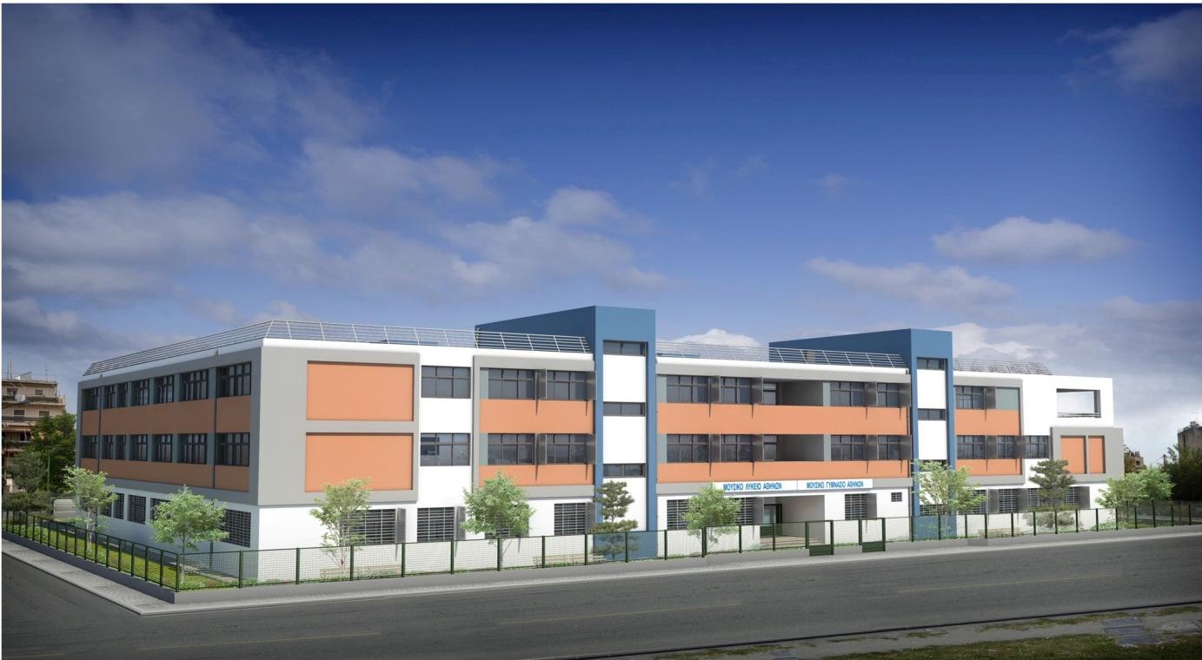

Alterative EU Funds: JESSICA instrument
Joint European Support for Sustainable Investment in City Areas
Unused EU funds reinvested in form of a loan
Lender replacement
Useful in case of financial scarcity and/or limitation of funds
Athens 22 Schools Projects
Coordinator, Financial Advisor
First PPP schooling transaction in Greece though two 27yrs PPP contracts;
22 school units servicing more than 5,000 students;
One of the first transactions combining EIB and JESSICA (EU) loans;
Project Financing:
Project Cost: €110bn
Senior Bank Debt: €90m
Alpha Loan participation: €18m
EU Funds: €40m
No project finance debt available with full state risk
Project completed during financial crisis (2014 – 2016)

Slide 13
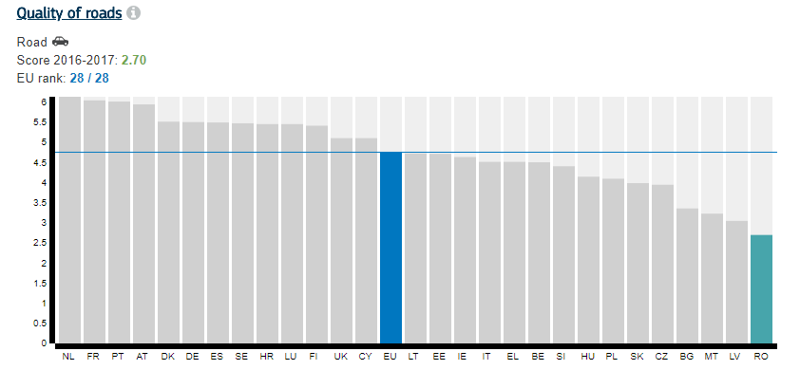
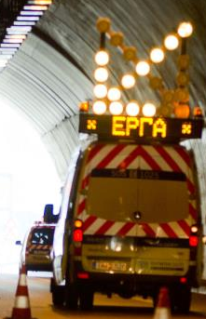
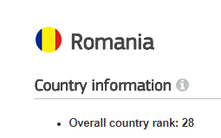
Romania
EU structural funds: a leverage tool to unlock serious project financing

