Slide 1


Structural funds in Romania Conference Notes
Horia Braun Erdei
Chief Economist & Head of Research, BCR
June 12th, 2018

Slide 2
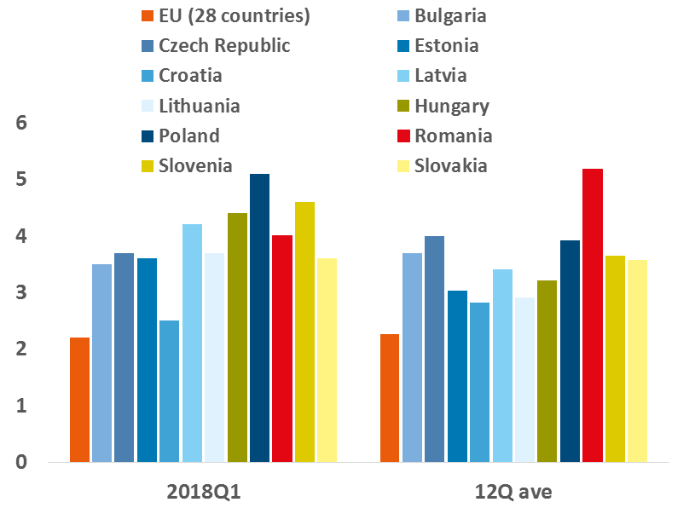
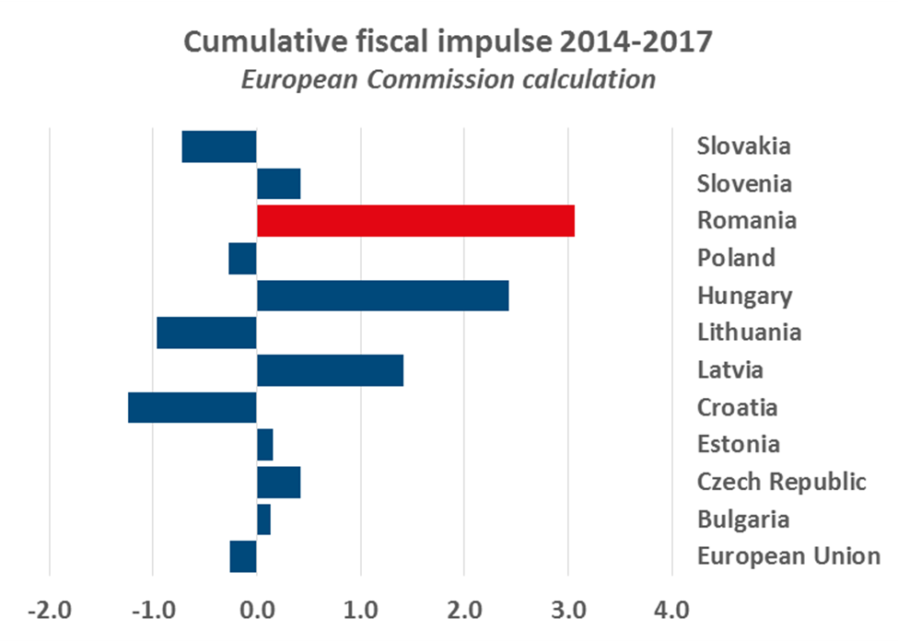
Romania – CEE growth tiger … on fiscal steroids
Source: Eurostat
Source: European Commission’s AMECO Database

Slide 3
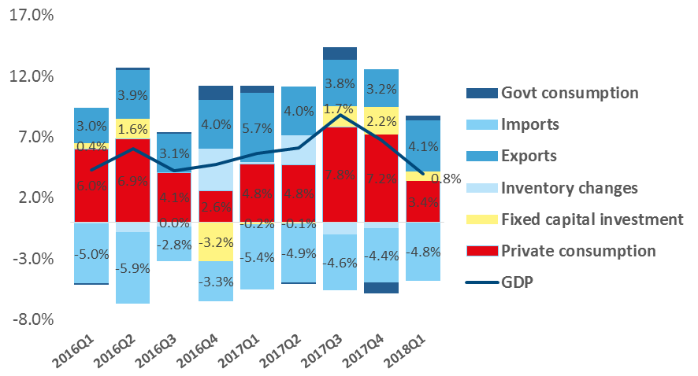
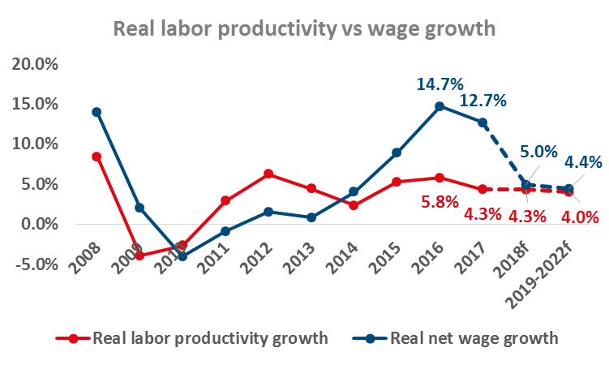
Romania’s growth engine needs swiftly a review
Source: NSI
… which implies a rotation of growth drivers from wages & consumption to productivity enhancing investments
Source: Eurostat

Slide 4
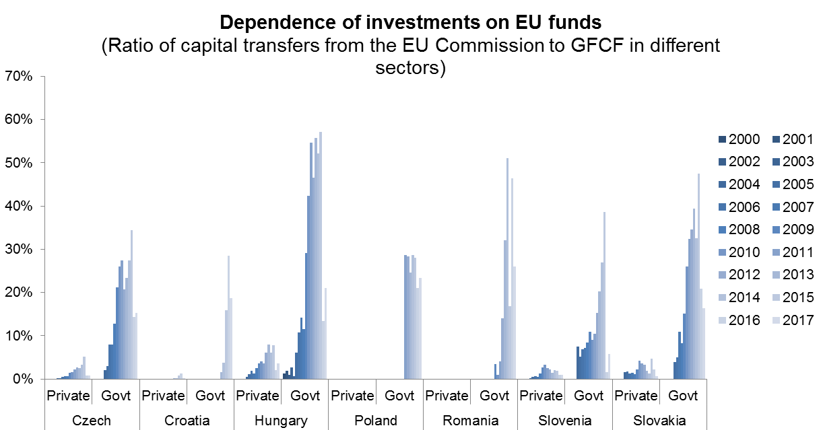
EU structural funds matter for (investment) growth
Source: Erste Bank Research calculations based on Eurostat data & National Central Banks data

Slide 5
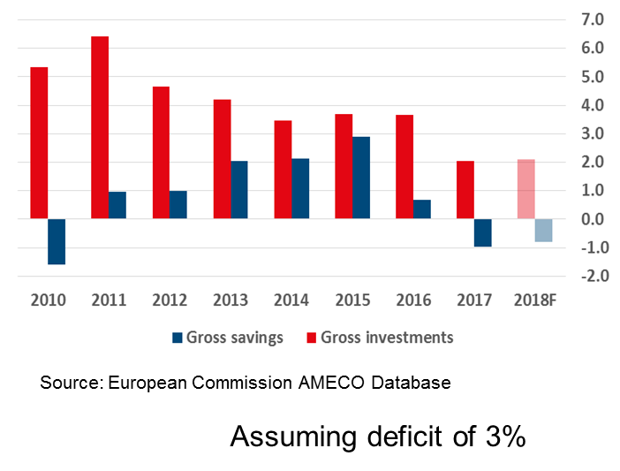
… especially in the context of tight national budget constraints
General consolidated budget savings & investments - ESA 2010, % of GDP -

Slide 6
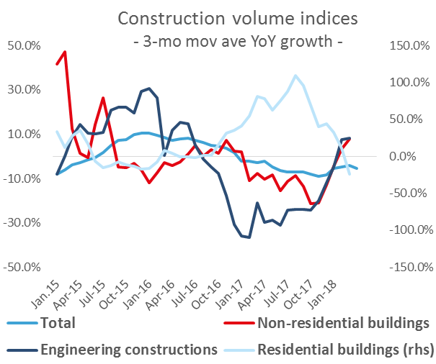
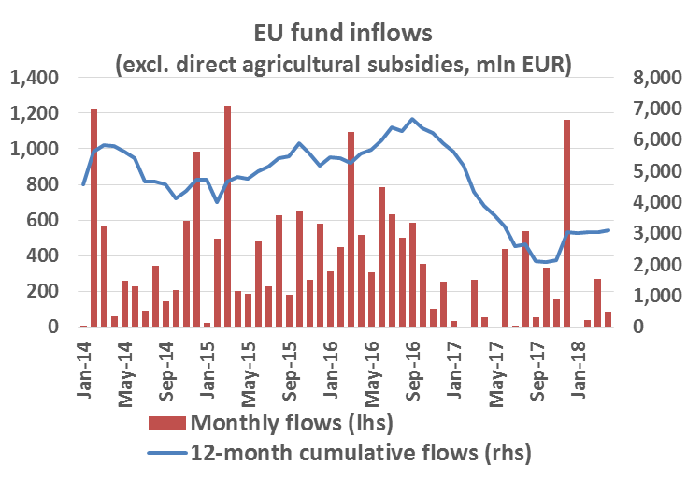
Public investments – from growth drag to growth driver
Source: National Statistics Institute
Source: National Bank of Romania

Slide 7
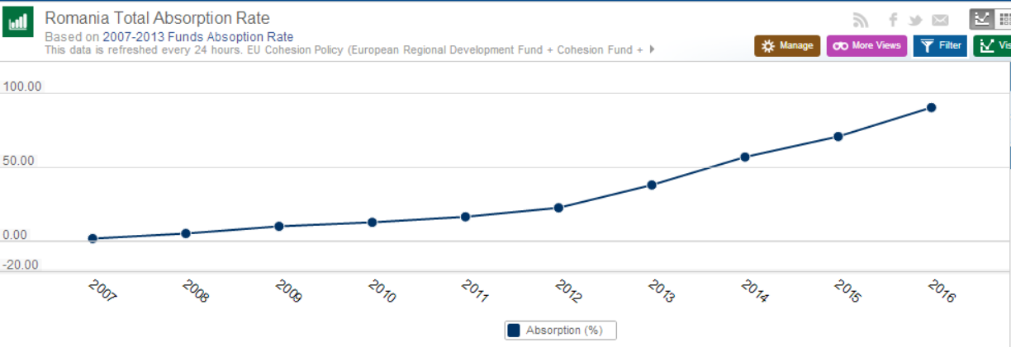
Romania’s EU funds absorption pattern heavily back-loaded
2014 2015 2016 2017 2018 2019 2020 2021 2022 2023
Source: European Commission

Slide 8
But the clock is ticking and EU priorities are changing
Source: https://cohesiondata.ec.europa.eu/countries/RO
Source: European Commission communication document*
Note*: “A Modern Budget for a Union that Protects, Empowers and Defends: The Multiannual Financial Framework for 2021-2027”

Slide 9
THANK YOU for your attention!

Slide 10
Disclaimer
This presentation is purely informative and does NOT constitute a recommendation for products or investments in financial instruments or an offer to purchase any products or investments in financial instruments that this report refers to. The bank has no obligation or responsibility regarding the offer of products presented to the client as described in this report. Any reference to a quotation or bid price in this report in connection with a product / service is purely indicative and does not represent a quotation or offer price available when the customer decides to purchase / contract that product / service. Detailed information on the specific terms and conditions under which clients may benefit from BCR products and services are provided to potential investors when applying for account opening and in due time before the provision of services requested.
Investments in financial instruments are subject to various risks, such as market risk, issuer-related risks derived from its financial position, or operational results, market price fluctuations that can result in price deviation of some structured instruments from the underlying asset price, risks arising from dividend policy, yields and/or profits, as well as from foreign exchange fluctuation.
It is possible that BCR, members of the group or employees thereof, hold in their own name products, services or financial instruments to which this report refers, buy, sell or perform any other type of transaction with such financial instruments, are market-makers for such products, services or financial instruments, offer investment banking services, lending or other services in connection with the relevant issuers specified in this report or provide intermediation services for public offerings in connection with such issuers.
Past performance of financial instruments does not guarantee future performance. No guarantee can be offered as to a favorable yield of a financial instrument portfolio or an issuer mentioned in the present report. There is a risk that, due to various factors, projections will not be met. Main causes behind this can be unlimited market volatility, sector volatility, stock volatility, lack of full access to complete and accurate source information and/or BCR or other sources prove to be incorrect. Neither BCR, nor its managers, collaborators or employees can be held responsible for losses or damages resulting from the use of this report, or its content or in any other way.
The use of website links in the present report does not entail BCR approving, recommending or certifying those websites, nor the information provided by the respective webpages. BCR does not take any responsibility for the content of those sites or for the information posted by those sites, nor for consequences derived from their use.
This document is solely addressed to the recipients. The document cannot be reproduced, distributed or published in full or in part for whatever reason without the written consent of BCR. By receiving the present document, the recipient agrees to the above-mentioned terms.
2017 Banca Comerciala Romana. All rights reserved.

