Slide 1




Demystifying GDPR
A practical introduction
Hilton Hotel Bucharest
23 October 2019

Slide 2
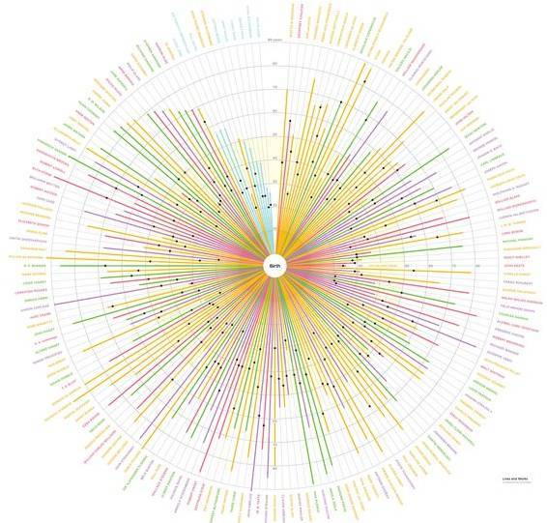
The GDPR fines are not just a threat
The Romanian DPA has imposed fines of EUR 325,000
Romanian bank fined with EUR 130,000 for breach of data related to 337,042 individuals
The Greek DPA imposed a fine of EUR 150,000 on one of the Big Four for asking consent from its employees
The Spanish DPA imposed a fine of EUR 30,000 on low budget airliner for not allowing users of its website to configure the cookies

Slide 3

Data Subjects: Natural persons only
Employees
Members of an Association
Clients
Suppliers
Contractors
Other third parties
(e.g. dependant family members)

Slide 4

Definition of Personal Data
Special Categories of (Sensitive) Personal Data
Personal Data
Any information relating to an identified or identifiable natural person
name, gender, age
address, phone number, email
ID Number, Tax ID Number
image, voice
IP address, geographic data
payroll, transactions
financial – social/family status
Personal data relating to:
racial or ethnic origin
political opinions, religious or philosophical beliefs or trade-union membership
genetic and biometric data
health
sexual life or sexual orientation

Slide 5

Identifying Processes
In which units and processes in you organization personal data is processed
Human Resources (HR) Department
hiring, payroll, paying taxes, leaves, training, dismissal etc.
Finance Department
Accounting, credit control, expense sheets etc.

Slide 6
Data Controller and Data Processor
Data Controller
Data Processor
The natural or legal person, public authority, agency or other body, which, alone or jointly with others, determines the purposes and means of the processing of personal data.
The natural or legal person, public authority, agency or other body which processes personal data on behalf of the controller.

Slide 7
Sources of Personal Data
The personal data may originate from:
The data subject itself
Publicly accessible sources (e.g. LinkedIn, Facebook)
Third Parties (e.g. Relatives, Suppliers, Clients)

Slide 8

When is processing permitted
If the data subject has consented to the processing: GDPR requires the consent in the form of an OPT-IN and not an OPT-OUT.
Other cases of permitted processing:
If it is necessary for the entry into or performance of a contract with the data subject
If it is necessary for the compliance of the data controller with a legal obligation
If it is necessary in order to protect the vital interests of the data subject or of another natural person
If it is necessary for the purposes of legitimate interests pursued by the controller or by a third party
If it is necessary for the performance of a task carried out in the public interest or in the exercise of official authority vested in the controller
Exceptions are stricter when special categories (sensitive) of personal data are involved.

Slide 9
Data Retention
Data Controller shall define a certain period of storage for the personal data of each purpose of processing
(e.g. recruitment, payroll, social insurance)
The retention period is necessary according to the storage limitation principle.
The criteria vary, depending on the purpose of processing (specific legal provisions, limitation periods, reasonable period that data will be useful for the controller).
However, the retention period may be suspended in terms of the legitimate interests pursued by the controller or third parties (internal audit, tax audit, litigation).

Slide 10
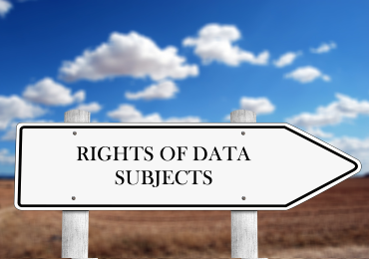
Data Subjects Rights
Right of Access
Right to Rectification
Right to Erasure (“to be forgotten”)
Right to Restriction of processing
Right to Data portability
Right to Object
Right to Withdraw consent

Slide 11

Breach of Personal Data
A breach of security leading to the accidental or unlawful destruction, loss, alteration, unauthorised disclosure of or access to personal data transmitted, stored or otherwise processed.
Examples:
web server hacked
theft of office documents
destruction of original documents
payroll data leak
corruption of files
Report in 72 hours

Slide 12


